Slide 1

Nazarbayev Intellectual school
Kokshetau
Subject, grade: English, 1st Grade
Unit 6 Traditions and folklore
Theme of the lesson: Story time

Slide 2
Lesson objectives:
1.R3 recognise some very high frequency words from local environment
1.L1 recognise short basic instructions for a limited range of classroom routines spoken slowly and distinctly
1.S3 pronounce basic words and expressions intelligibly

Slide 3
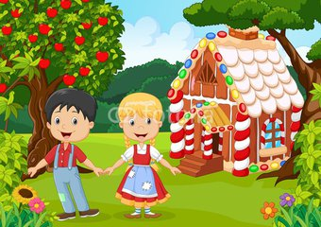
Hans and Gretta
Hansel and Gretel
Hantel and Gresel
Hunter and Granny

Slide 4
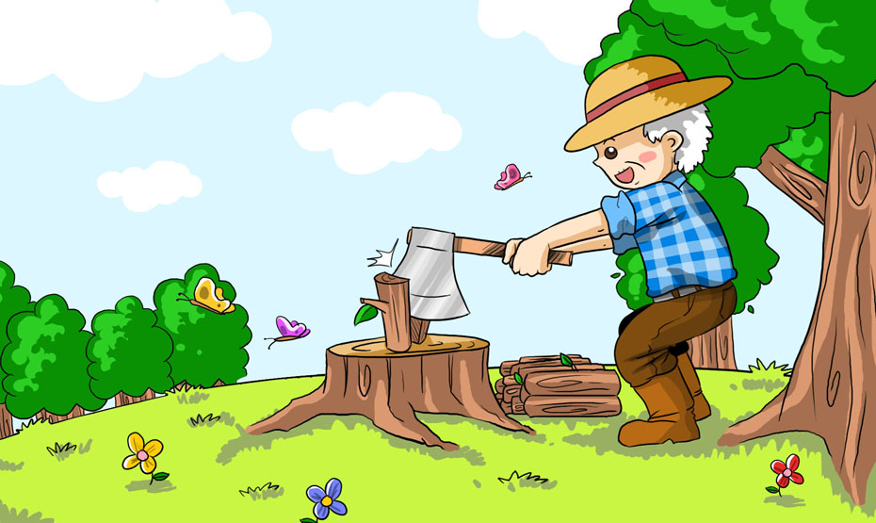
woodflutter
woodcutter
woodmatter
woodbutter

Slide 5

mood
blood
food
good

Slide 6

no boney
no money
no honey
no roney

Slide 7

sungry
hungry
mungry
fungry

Slide 8
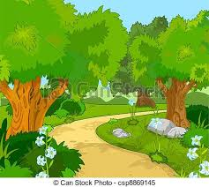
forest
torest
forist
florist

Slide 9
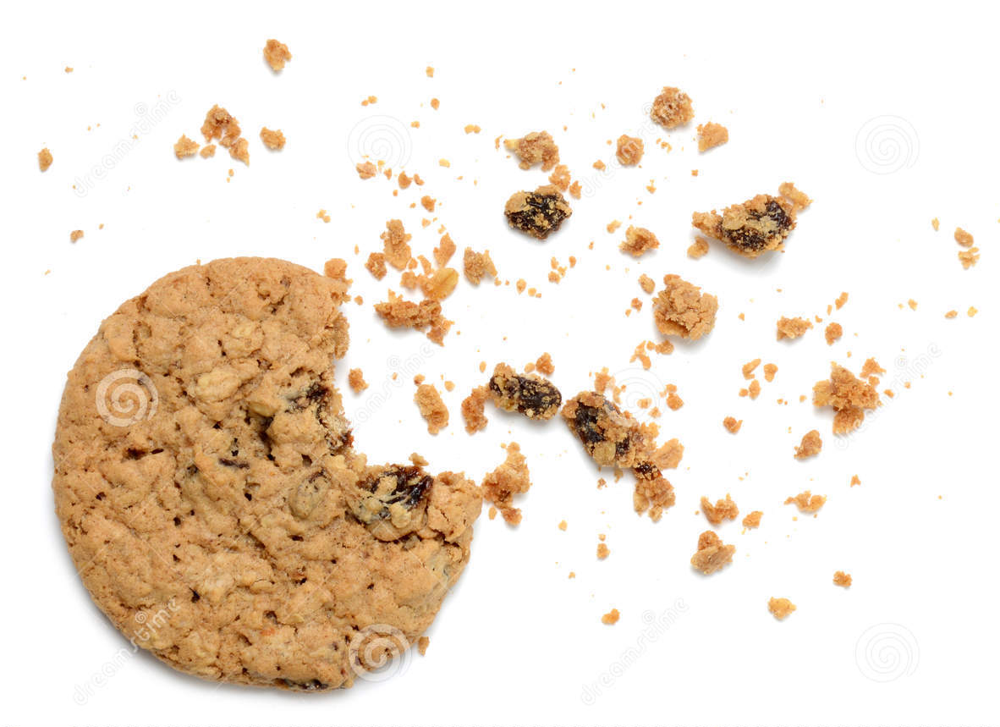
crumbs
dumbs
krumbs
crums

Slide 10
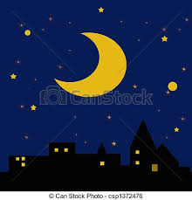
mark
park
shark
dark

Slide 11
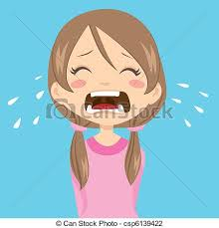
cry
dry
try
kry

Slide 12
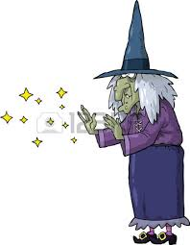
witch
vitch
mitch
hitch

Slide 13
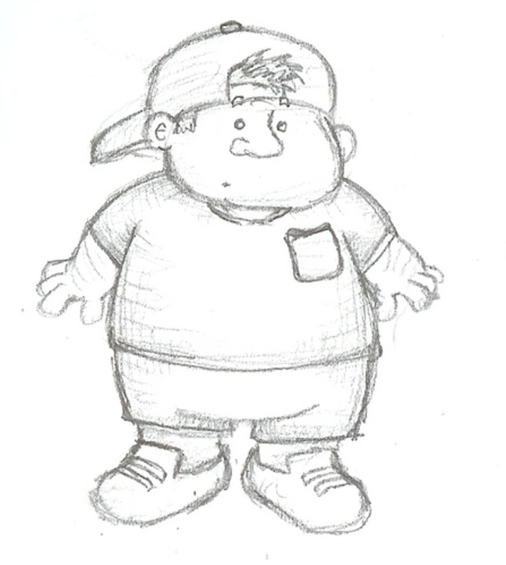
bat
cat
fat
mat

Slide 14
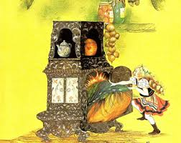
ovn
oven
aven
even

Slide 15

tire
fire
hire
mire

Slide 16
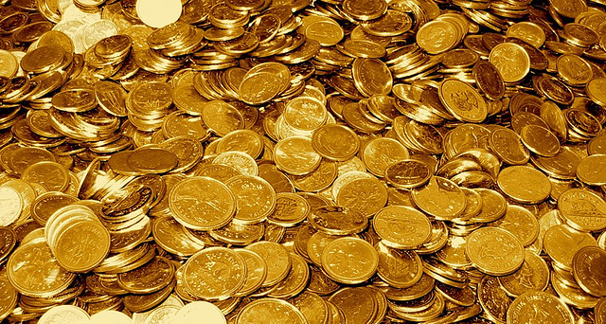
mold gold
bold
cold

Slide 17

pappy
happy
nappy
mappy

