Slide 1
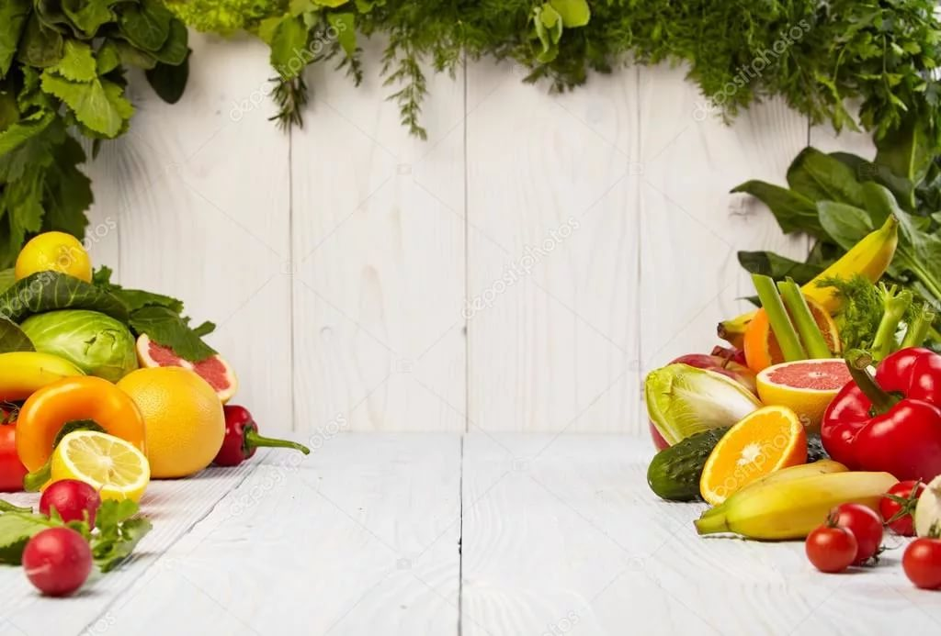
FRUITS AND VEGETABLES

Slide 2
CONNECT SYLLABLES
App- nge
Ban- le
Ora- ar
Straw- ana
Pe- atoes
Car- berry
Oni- ember
Pot- rot
Cab- bage
Cuc- ons

Slide 3
PUT MISSING LETTERS
1. _ppl_
2. b_n_n_
3. _range
4. p_ar
5. _nions

Slide 4
FRUITS VEGETABLES

Slide 5
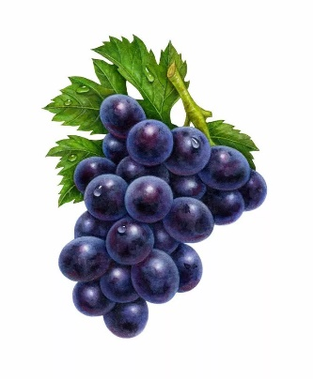
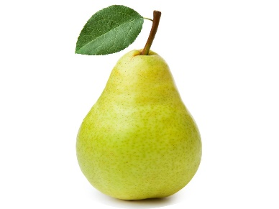
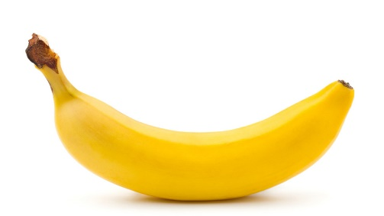
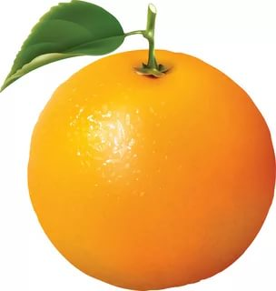
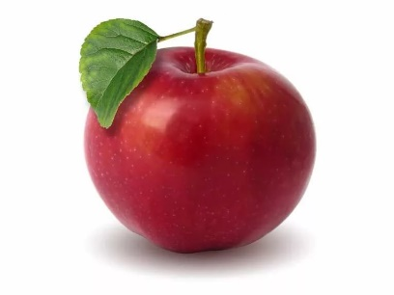
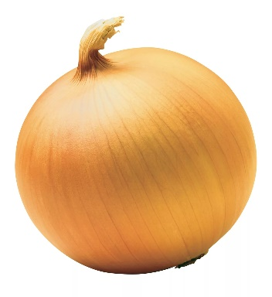
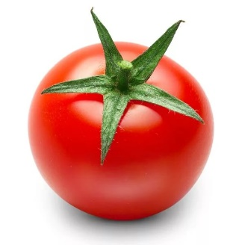
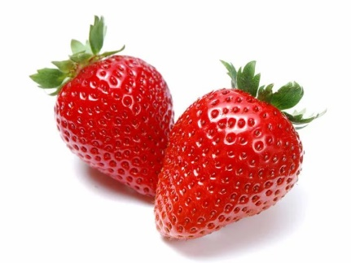
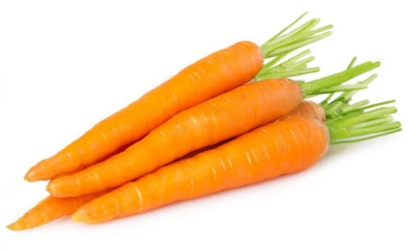
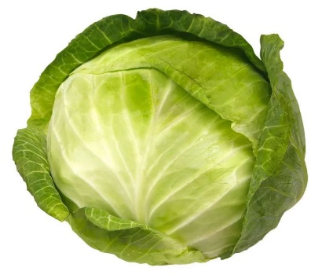
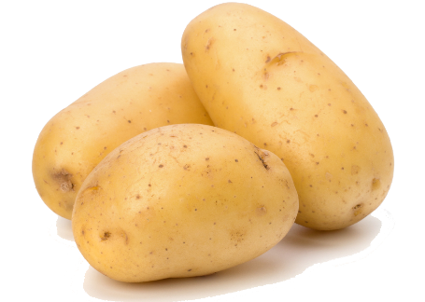
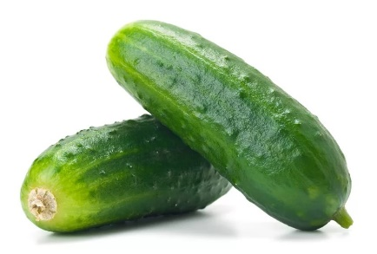
APPLE
PEAR
BANANA
ORANGE
GRAPES
STRAWBERRY
TOMATO
CARROT
ONION
POTATO
CABBAGE
CUCUMBER

Slide 6
Hands up, hands down,
Hands on hips,
Sit down, stand up.
Hands on hips
Bend left, bend right,
Hands to shoulders
1-2-3-4 back 1-2-3-4.
Stand still.

Slide 7
A black cat
Sat on a mat
And ate a fat rat.

