Slide 1


Theme: Lifestyle or genes
Key words of the lesson: stages of life, approximate ages, lifespan, genetics, healthy and unhealthy habits
Slogan: The healthier we are, the better we feel. The better we feel, the longer we live

Slide 2
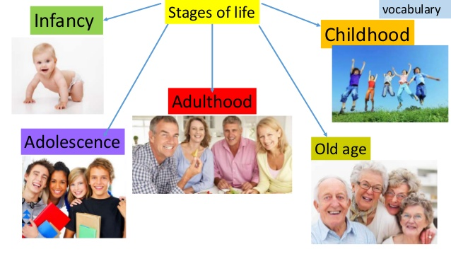
What are the stages of life?
What do you think the age range is for each time of life?
Baby
Toddler
Child
Teenager
Adult
(be) middle aged
Pensioner
(be) old/ elderly

Slide 3

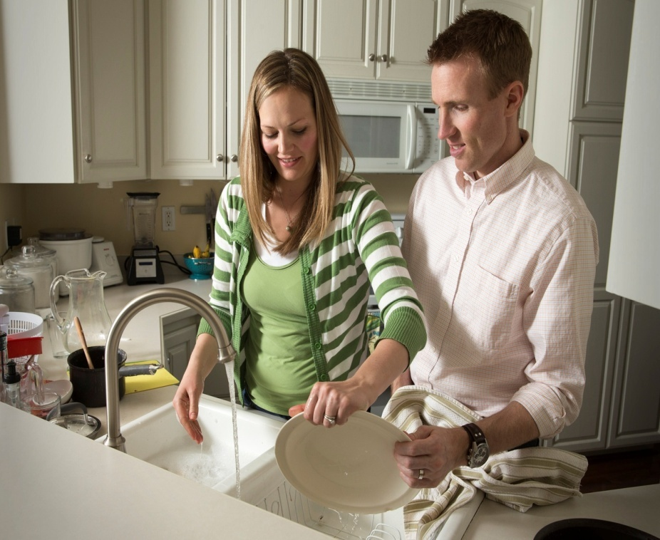

Approximate ages
When we don’t know the exact age of a person we use the expressions below:
To be in somebody’s early/late/ mid- twenties, thirties;
Roughly/approximately/almost/nearly means about, more or less

Slide 4
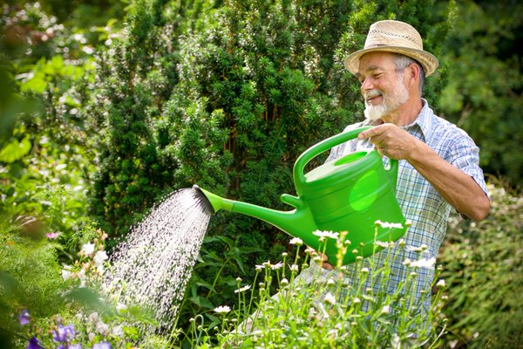



What is the typical age to do these things in our country?
Have children
Rebel against your parents
Get a job
Get engaged
Look after your grandchildren5`
Retire
Get married
Graduate from university
Earn a good salary
Learn to drive a car

Slide 5

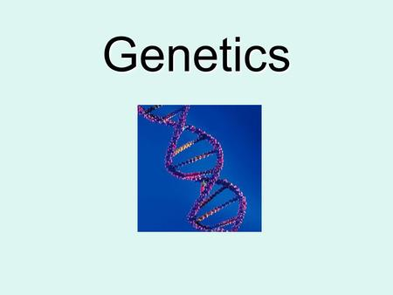
What affects the most to live long? Lifestyle or genetics

Slide 6
In pairs ask and answer the questions in the quiz
AGEING
How much do you know about it?
On average, which nationality lives the longest?
The Japanese
The Italians
The Swedish
2) What was the average lifespan 2000 years ago?
26 years
36 years
46 years
3) By 2050, what percentage of the world’s population will be 65 or older?
2%
10%
20%
4) On average, which groups of people live longer?
Smokers or non-smokers?
Single people or married people?
Pet owners or non-pet owners?

Slide 7
Brainstorming
Lifestyle or genetics

Slide 8

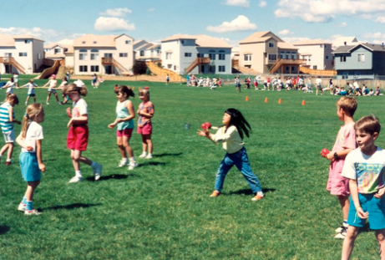
Conclusion
How long you will live isn’t necessarily affected by genes.
Instead it is how you live your life determines how old you will get
The sooner you take on healthy habits the better

Slide 9
Have a nice day
Thank you for your attention

